Slide 1
LearnMate - Agentic-AI for Personalized Course Pathways
CAPSTONE PROJECT
Presented By:
Student name : DONA SHARMA
College Name & Department : SHIVAJIRAO S. JONDHALE COLLEGE OF ENGINNERING , DEPARTMRNT OF COMPUTER ENGINNERING

Slide 2
OUTLINE
Problem Statement
Technology used
Wow factor
End users
Result
Conclusion
Git-hub Link
Future scope
IBM Certifications

Slide 3
Problem Statement
In the current educational landscape, students are often overwhelmed by the vast number of courses available, making it difficult to identify the right learning path that matches their individual goals, interests, and skill levels. The lack of clear guidance and structured course progression can lead to confusion, inefficient learning, and missed opportunities for skill development. There is a growing need for intelligent systems that can assist students in navigating their educational journey more effectively.
Proposed Solution: An AI LearnMate Agent that uses Natural Language Processing (NLP), Retrieval-Augmented Generation (RAG), to assist students in identifying their interests and give personalized course pathways that change and updates as skills progress.

Slide 4
Technology used
IBM cloud lite services
Natural Language Processing (NLP)
Retrieval Augmented Generation (RAG)
IBM Granite model

Slide 5
IBM cloud services used
IBM Cloud Watsonx AI Studio
IBM Cloud Watsonx AI runtime
IBM Cloud Agent Lab
IBM Granite foundation model

Slide 6
Wow factors
Personalized Course Roadmaps LearMate crafts unique learning journeys tailored to each student’s background, goals, and pace.
AI-Powered Skill Gap Detection Instantly identifies missing prerequisites and recommends the right foundational courses to bridge knowledge gaps.
Career-Aligned Pathways Aligns course selections with real-world job roles and trending industry demands.
Real-Time Adaptive Suggestions Dynamically updates recommendations based on user progress, performance, and evolving interests.
Conversational AI Interface Lets students chat naturally with LearnMate to ask questions, explore hways, and get instant academic guidance.

Slide 7
End users
Students
Career Changers
Academic Advisor and Mentor
Working Professionals

Slide 8
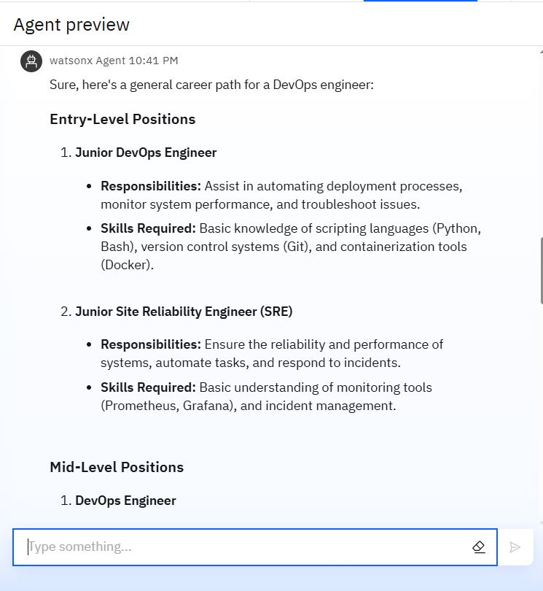
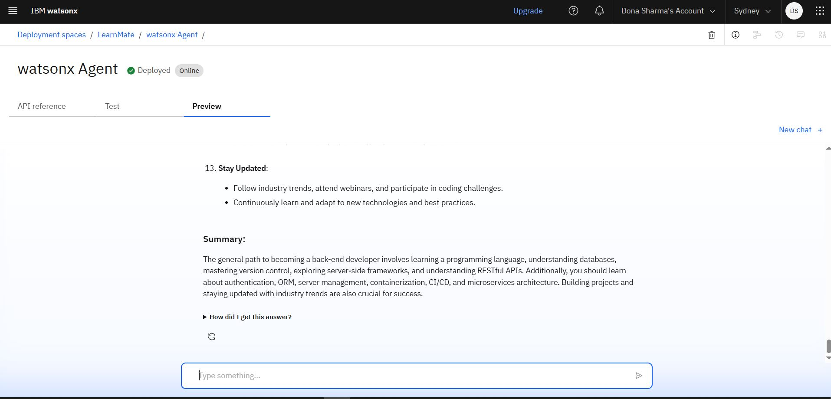
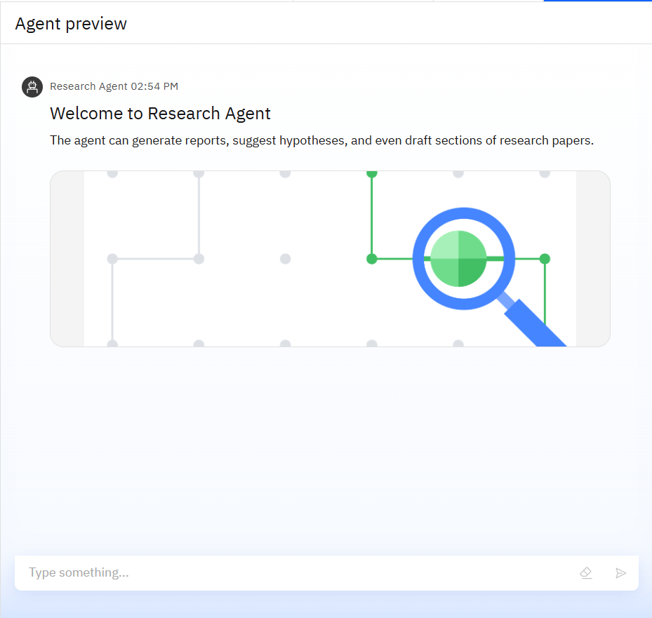
Results

Slide 9
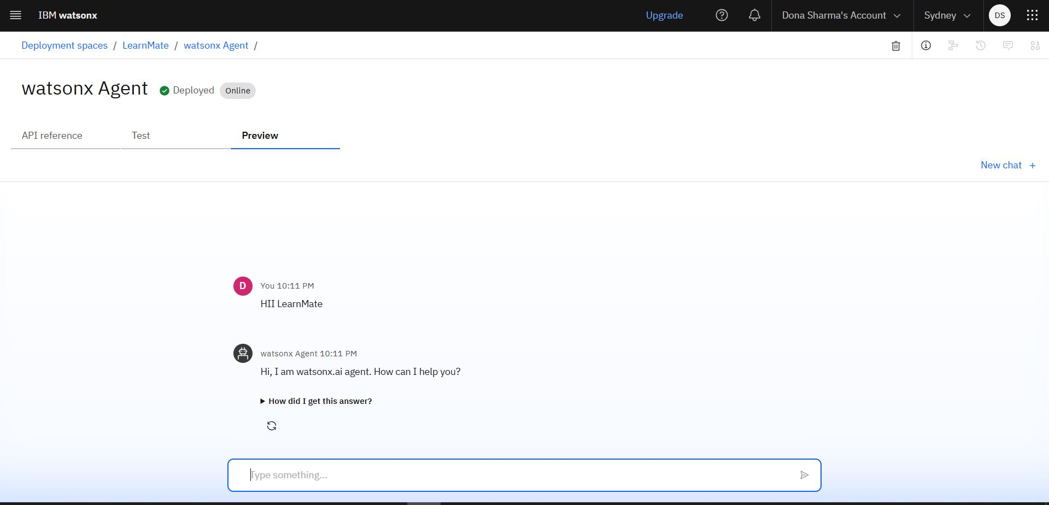
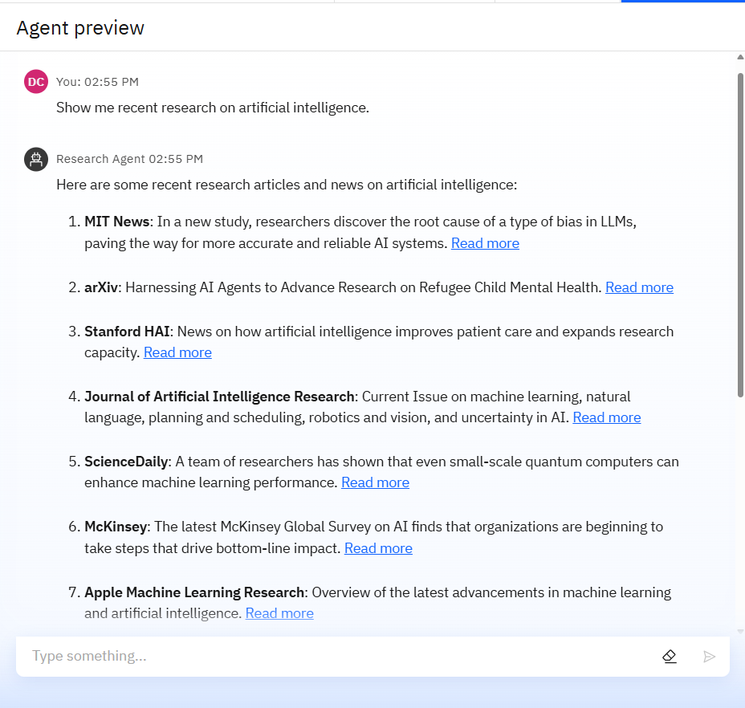
Results

Slide 10
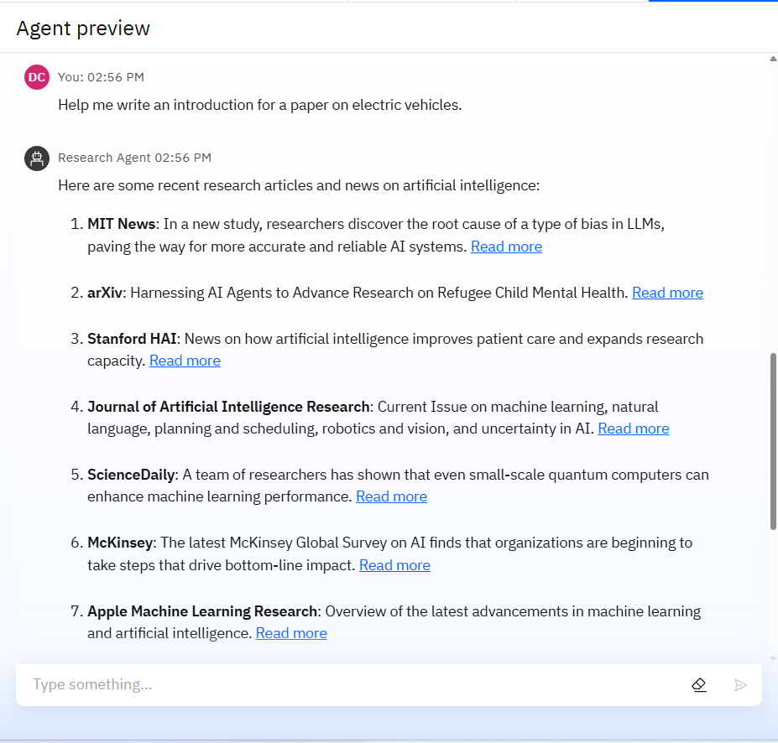
Results

Slide 11
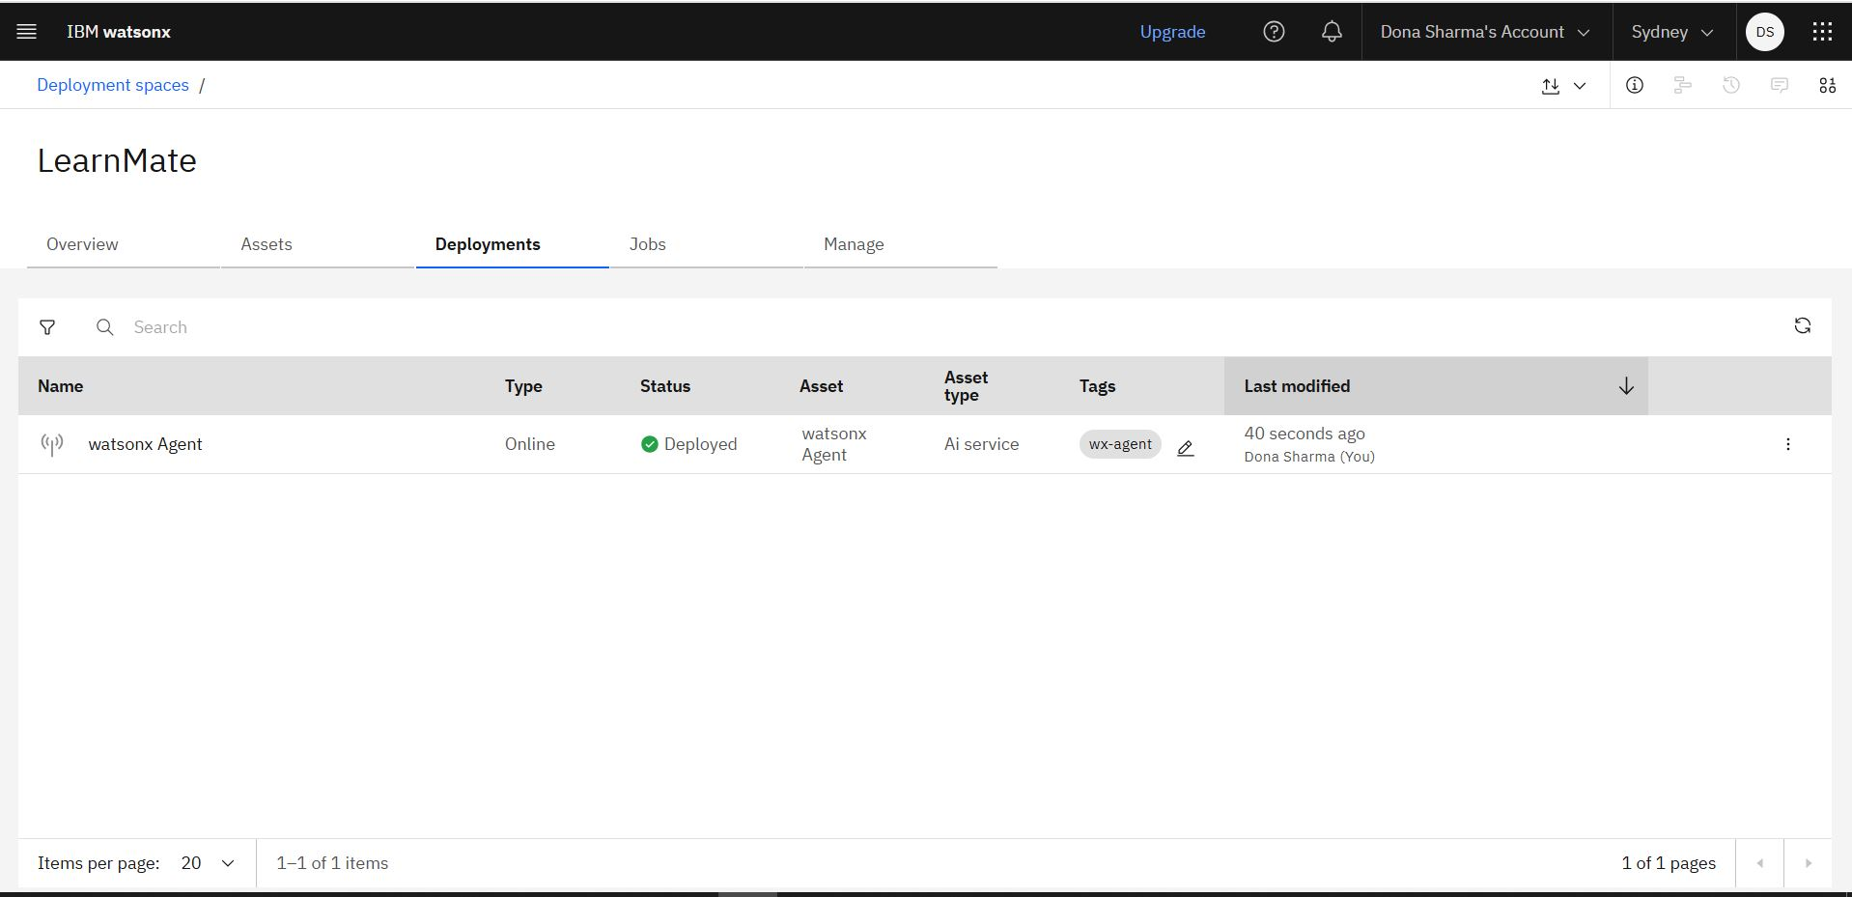
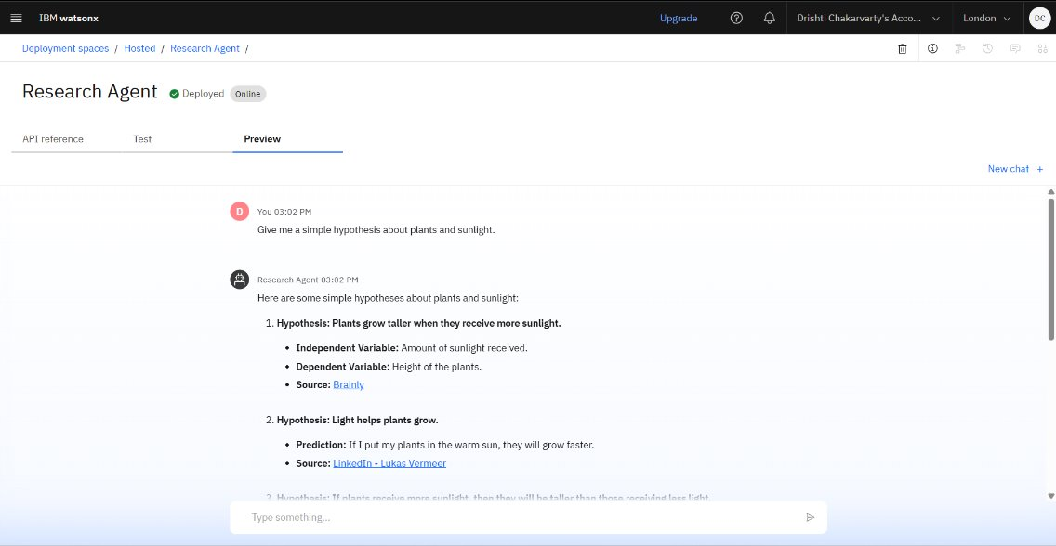
Results
Deployed AI Agent

Slide 12
Conclusion
LearnMate addresses a critical gap in the education system by offering intelligent, personalized guidance for course selection and progression.
By leveraging AI to understand individual learner needs, track progress, and align pathways with real-world goals, LearnMate empowers students to make informed academic decisions, enhances learning efficiency, and supports institutions in delivering better educational outcomes.

Slide 13
Future scope
Global platform integration
Career trend-based recommendations
Peer mentorship features
Multilingual support
Support for lifelong learning

Slide 14
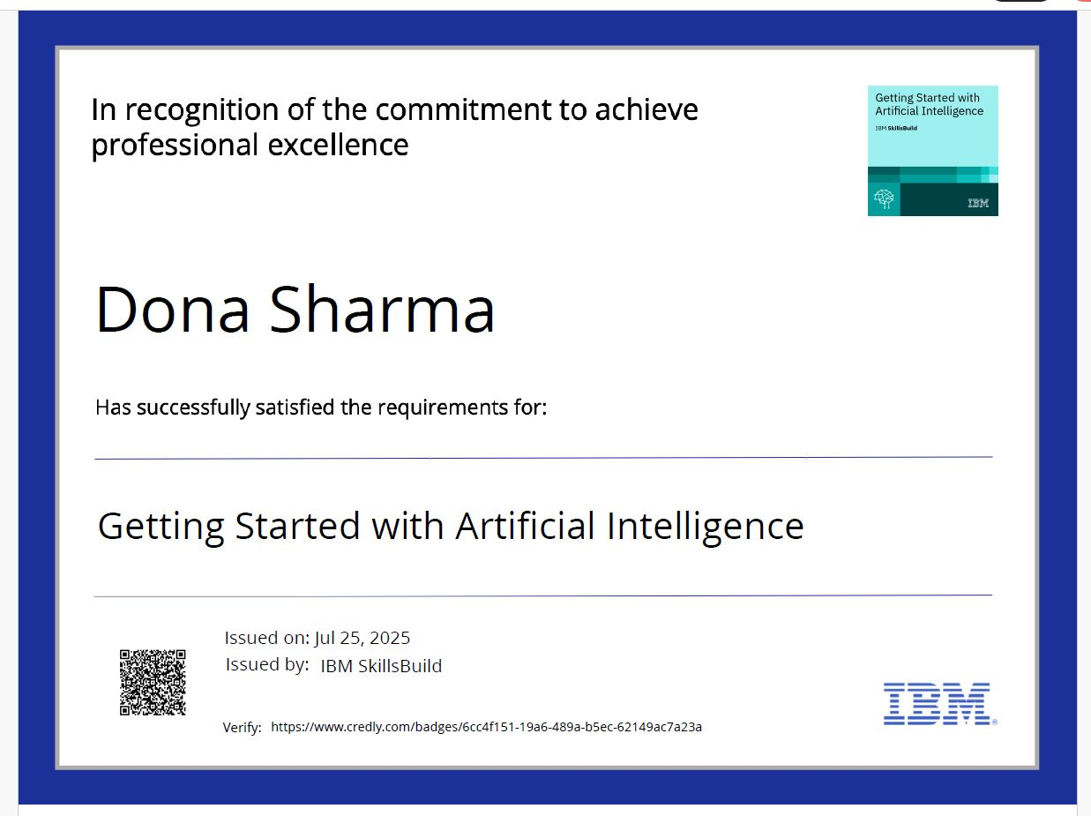
IBM Certifications

Slide 15
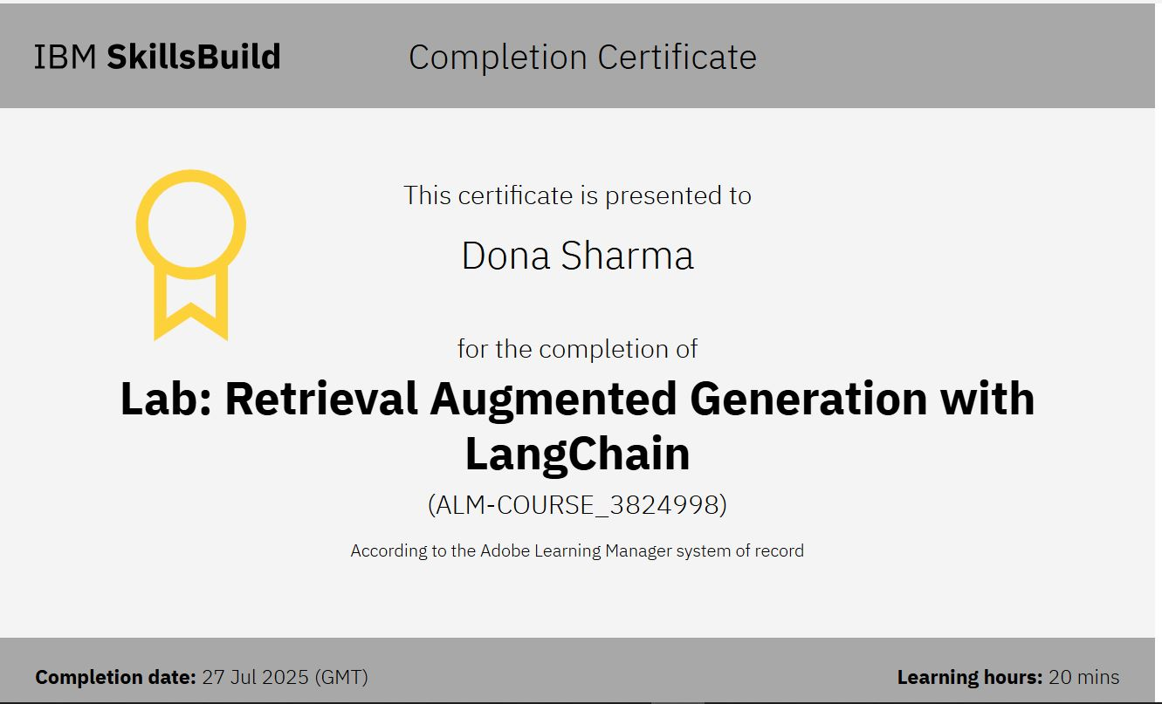
Attach your RAG LAB certificate here

Slide 16
Git hub lik : https://github.com/donasharma08/LearnMate-Agentic-AI-for-Personalized-Course-Pathways/upload/main

Slide 17
THANK YOU

